Slide 1

Wrestling and the Dental Mouth Guard
Tyler L. Scott, DDS
Wayne County Wrestling Officials Association
Wayne County, Ohio

Slide 2

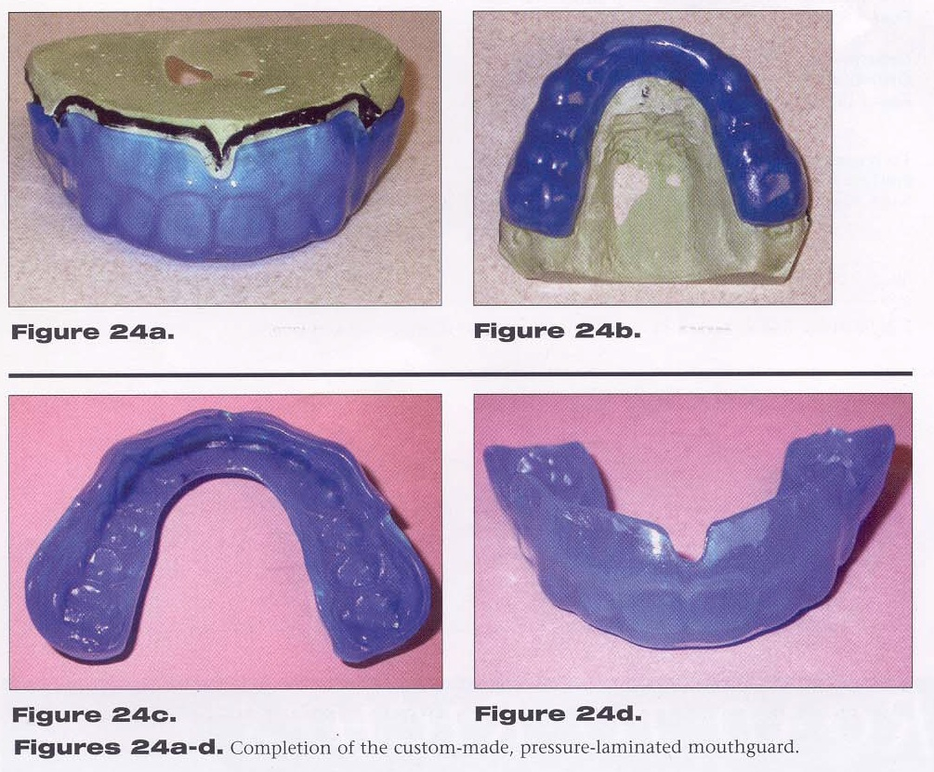
Dental Mouth guard
A mouth guard, usually a flexible piece of plastic that fits into the mouth, should be worn during all recreational and athletic activities to protect the mouth and teeth from serious injury - especially activities where there is contact or potential contact with another person, piece of equipment, or the ground.

Slide 3
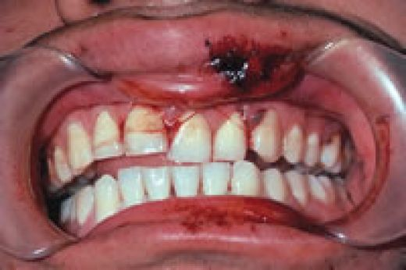

Preventable Injuries using Mouth guards
Injuries to the teeth, mouth, and head may include the following, many of which could be prevented with proper and consistent use of a mouth guard:
  dislodged or knocked out tooth/teeth
  concussion
  cerebral hemorrhage
  broken or chipped teeth
  bitten or lacerated tongue and/or lip
  objects caught/lodged between the teeth
  jaw fracture
Do you think this athlete may also have signs of a concussion?
Ohio State University College of Dentistry: www.dent.osu.edu

Slide 4
2011-12 NFHS Wrestling Rule
Rule 4.2.6 (page 17)
Each contestant who has braces or has a special orthodontic device on his or her teeth, shall be required to wear a tooth and mouth protector. A tooth and mouth protector (intraoral) shall include an occlusal (protecting and separating the biting surfaces) and a labial (protecting the teeth and supporting structures) portion and cover the teeth and all areas of the braces or special orthodontic device with adequate thickness. This would include upper and lower teeth if devices are present on both. It is recommended the protector be properly fitted and:
a. Constructed from a model made from an impression of the individual's teeth and braces or special orthodontic device.
b. Constructed and fitted to the individual by impressing the teeth and braces or special orthodontic device into the tooth and mouth protector itself.

Slide 5
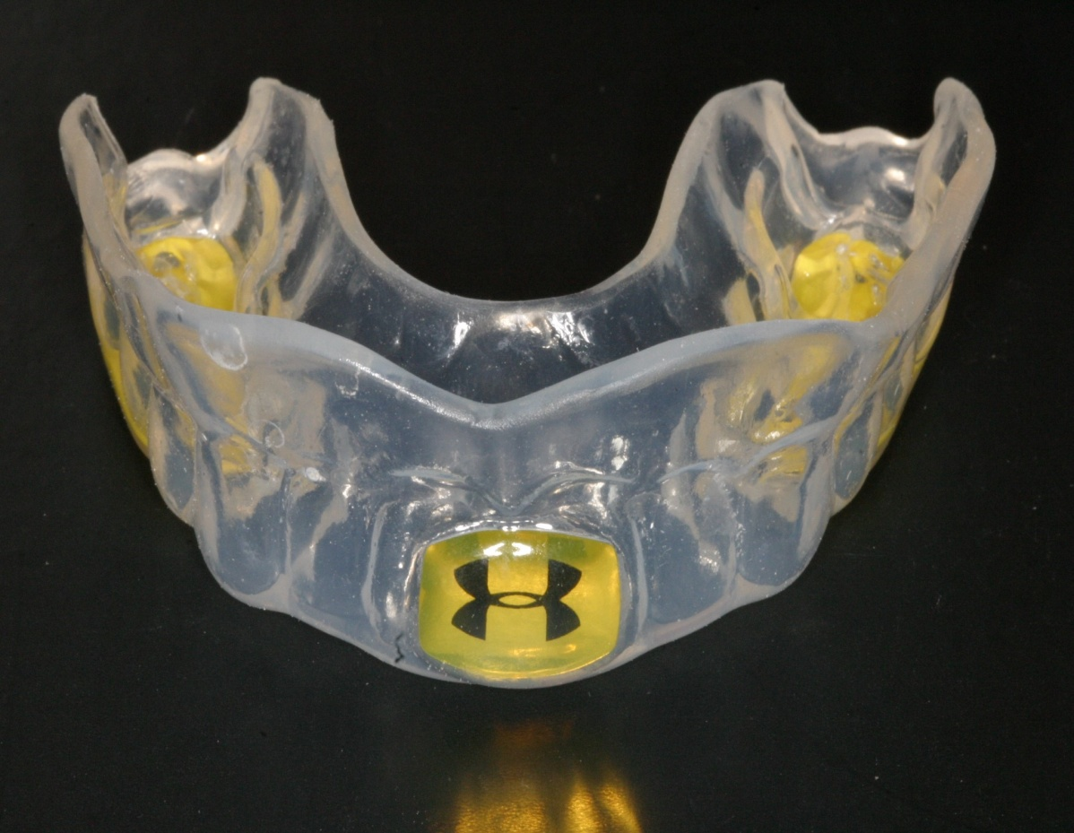

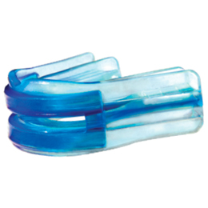
Mouth guard Examples (Legal)
Under amour Brand Mouth guard
(legal for only upper braces)
Boil and Bite Mouth guard
(legal for upper and lower braces)
www.underarmour.com

Slide 6
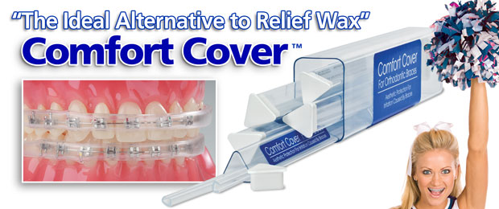
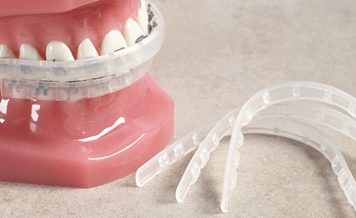


Mouth guard Examples (Illegal)
Lip Protectors
Comfort Cover is ideal for contact sports where a mouth guard is excessive
Perfect for patients involved in light contact sports
• A must for musicians
• Great for light contact sports
• Improves patient comfort
• Eliminates patient wax
• Works well on difficult patients
Ortho Technology's Comfort Cover shields the patient's lips and cheeks from the discomfort often associated with orthodontic treatment or activities where the risk of oral laceration could occur, such as playing musical instruments or light contact sports where mouth guards are excessive.
www.orthotechnology.com

Slide 7

Summary
  Mouth guards are required for wrestlers that have either upper and/or lower braces.
  Mouth guards need to cover not only the braces but the entire arch of teeth.
  Single tubes, straps or bumpers that cover only the braces are illegal and should be deemed a technical violation.

